Slide 1

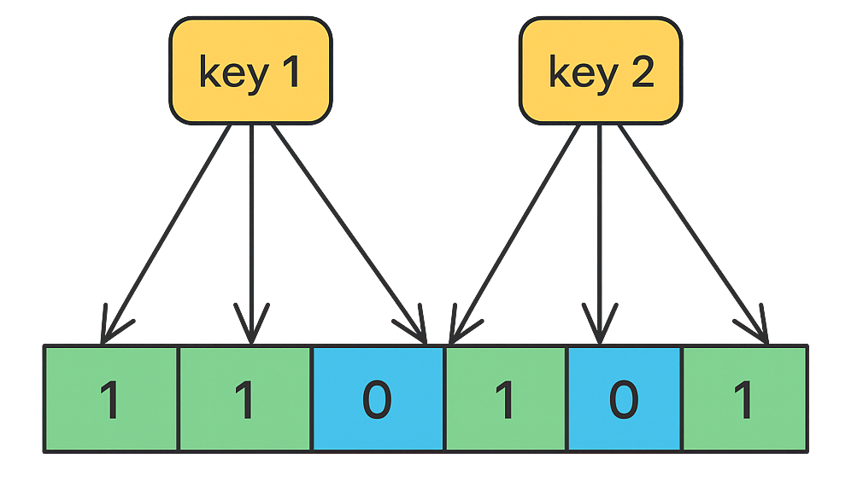
What are Bloom Filters ?
Have you ever wondered how Netflix knows which shows you've already watched? Or how Amazon avoids showing you products you've already purchased?
Using a traditional data structure like a hash table for these checks could consume significant amount of memory, especially with millions of users and items.
Instead, many systems rely on a more efficient data structure a Bloom Filter.

Slide 2
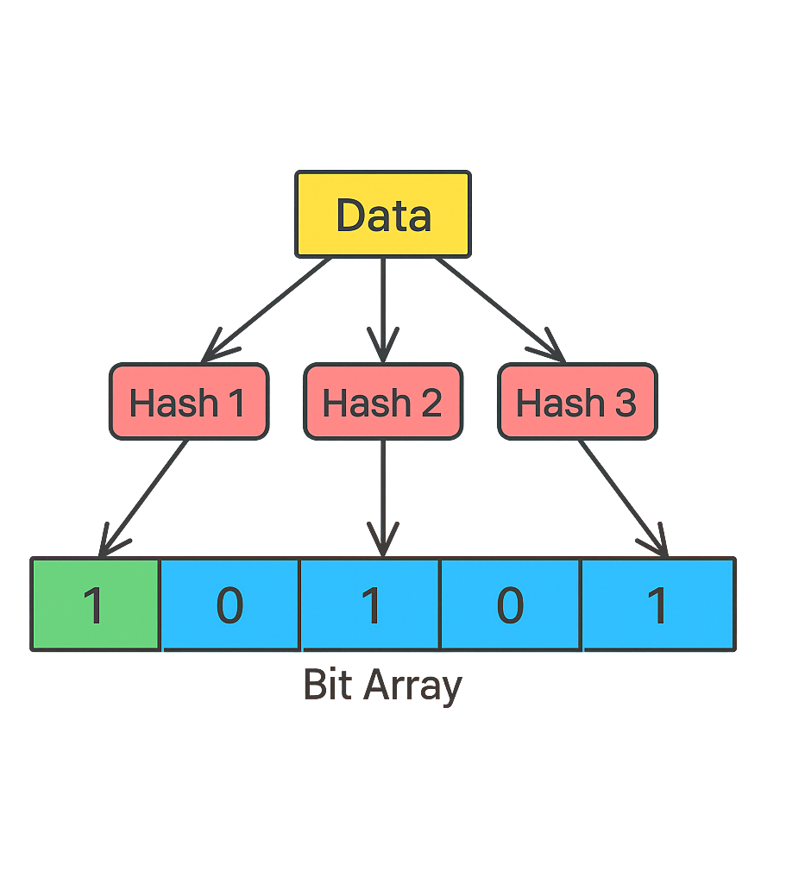
What is a Bloom Filter?
A Bloom Filter is a probabilistic data structure that allows you to quickly check whether an element might be in a set.
It’s useful in scenarios where you need fast lookups and don’t want to use a large amount of memory, but you’re okay with occasional false positives.
Key Components of a Bloom Filter:
Bit Array: The Bloom Filter consists of a bit array of a fixed size, initialized to all zeros. This array represents whether certain elements are in the set.
Hash Functions: To add or check an element, a Bloom Filter uses multiple hash functions. Each hash function maps an element to an index in the bit array.

Slide 3
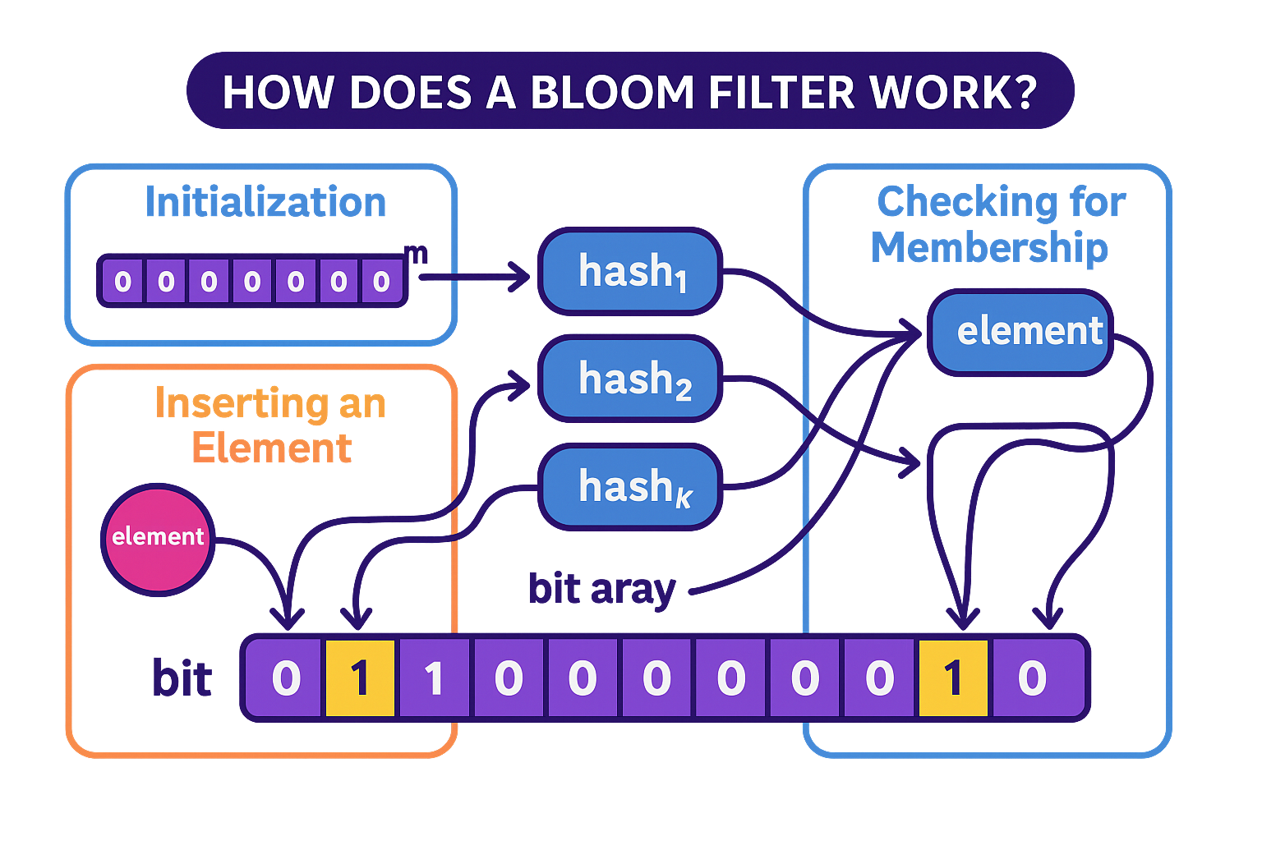
How Does a Bloom Filter Work?
A Bloom filter works by using multiple hash functions to map each element in the set to a bit array.
1. Initialization:
A Bloom filter starts with an empty bit array of size m (all bits are initially set to 0).
It also requires k independent hash functions, each of which maps an element to one of the m positions in the bit array.
2. Inserting an Element:
To insert an element into the Bloom filter, you pass it through each of the k hash functions to get k positions in the bit array.
The bits at these positions are set to 1.
3. Checking for Membership:
To check if an element is in the set, you again pass it through the k hash functions to get k positions.
If all the bits at these positions are set to 1, the element is considered to be in the set (though there's a chance it might be a false positive).
If any bit at these positions is 0, the element is definitely not in the set.

Slide 4
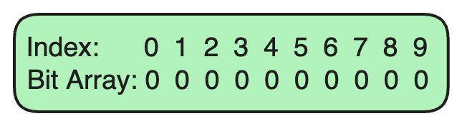
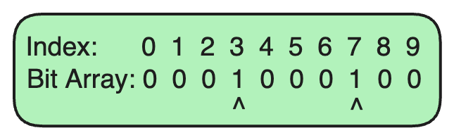
Using a Bloom Filter for URL Checking
Imagine you're building a web crawler that needs to keep track of which URLs it has already visited.
Instead of storing every URL (which would require a lot of memory), you decide to use a Bloom Filter.
Step 1: Set Up the Bloom Filter
Initialize a Bit Array: Let’s assume our Bloom Filter uses a bit array of size 10, initially all set to 0.
Choose Hash Functions: We’ll use two hash functions in this example. These hash functions take an input (like a URL) and output an index in the bit array.
Step 2: Adding a URL to the Bloom Filter
Suppose we want to add the URL example.com to our Bloom Filter.
Hash Function 1 generates an index of 3 for example.com.
Hash Function 2 generates an index of 7 for example.com.
We set the bits at indices 3 and 7 in the bit array to 1.

Slide 5
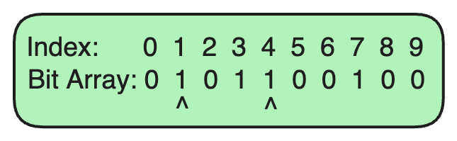

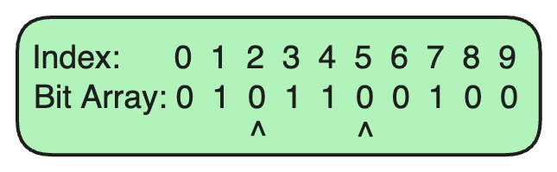
Using a Bloom Filter for URL Checking
Step 3: Adding Another URL
Now, let's add another URL, algomaster.io.
Hash Function 1 generates an index of 1 for algomaster.io.
Hash Function 2 generates an index of 4 for algomaster.io.
We set the bits at indices 1 and 4 in the bit array to 1.
Step 4: Checking for a URL in the Bloom Filter
Suppose we want to check if example.com is already in the Bloom Filter.
Hash Function 1 generates index 3 for example.com.
Hash Function 2 generates index 7 for example.com.
Since both bits at indices 3 and 7 are set to 1, we can say that example.com is probably in the set (there's a small chance of a false positive).
Step 5: Checking for a Non-Existent URL
Now, let's check if nonexistent.com is in the Bloom Filter.
Hash Function 1 generates index 2 for nonexistent.com.
Hash Function 2 generates index 5 for nonexistent.com.
Since the bits at indices 2 and 5 are both 0, we can confidently say that nonexistent.com is not in the set.

Slide 6
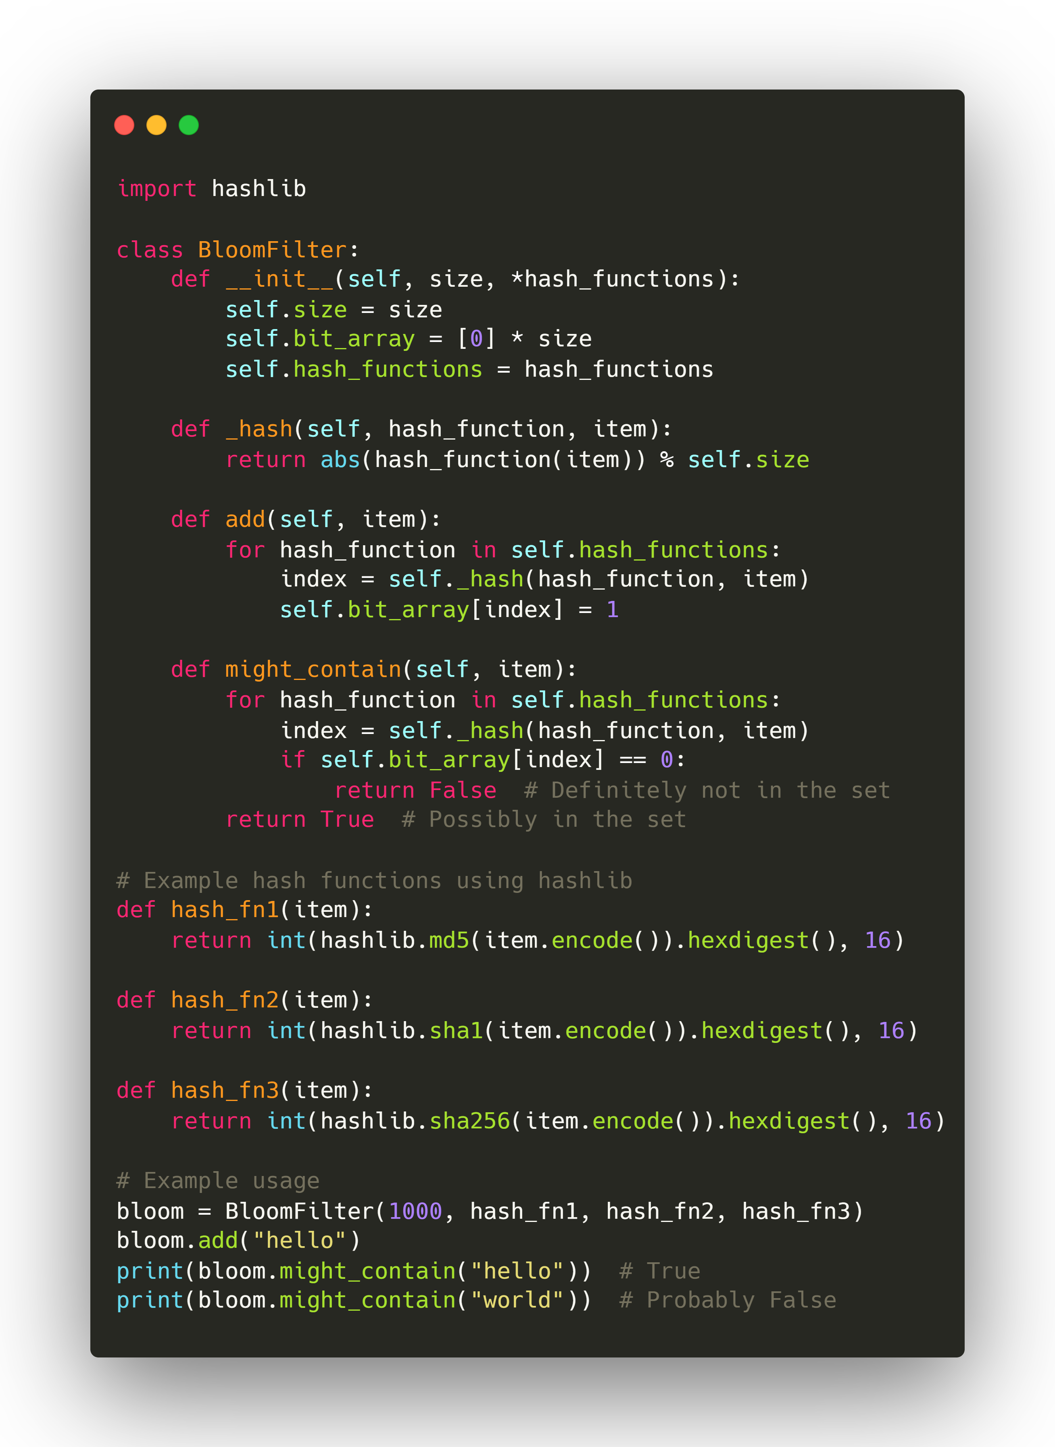
Bloom Filter Python Code
Key Features:
Uses a bit array to store set membership information.
Employs multiple hash functions to set/check bits.
Highly efficient in both space and time.
Implementation Highlights:
Implemented using native Python structures: list and hashlib.
Customizable via multiple hash functions (MD5, SHA1, SHA256).
add(item) sets corresponding bits for the item.
might_contain(item) checks if all bits for the item are set.
Trade-Off:
False positives are possible: an item may appear to be present even if it’s not.
No false negatives: if it returns False, the item is definitely not in the set.
Use Cases:
Caches, databases, network security, spell checkers, blockchain, and more.

Slide 7
Real-World Applications of Bloom Filters
1. Web Caching
A Bloom Filter can be used to quickly check if a URL might be in the cache. When a request arrives, the Bloom Filter is checked first. If the Bloom Filter indicates the URL is “probably in the cache,” a cache lookup is performed.
2. Spam Filtering in Email Systems
A Bloom Filter can store hashes of known spam email addresses. When a new email arrives, the Bloom Filter checks if the sender's address might be in the spam list.
3. Limited to Set Membership Queries
Many databases, such as Cassandra, HBase, and Redis, use Bloom Filters to avoid unnecessary disk lookups for non-existent keys. The Bloom Filter quickly checks if a key might be present. If the Bloom Filter indicates “not present,” it can skip the database lookup.
4. Content Recommendation Systems
A Bloom Filter can track the content each user has previously watched or interacted with. When generating new recommendations, the Bloom Filter quickly checks if an item might already have been consumed.
5. Social Network Friend Recommendations
A Bloom Filter is used to store the list of each user’s existing connections. Before suggesting new friends, the Bloom Filter can be checked to ensure the user isn’t already connected with them.

Slide 8
Limitations of Bloom Filters
1. False Positives
Bloom Filters can produce false positives, meaning they may incorrectly indicate that an element is present in the set when it is not.
2. No Support for Deletions
Standard Bloom Filters do not support element deletions. Once a bit is set to 1 by adding an element, it cannot be unset because other elements may also rely on that bit.
3. Limited to Set Membership Queries
Bloom Filters are specifically designed to answer set membership queries. They do not provide information about the actual elements in the set, nor do they support complex queries or operations beyond basic membership checks.
4. Not Suitable for Exact Set Membership
Bloom Filters are probabilistic, meaning they cannot provide a definite “yes” answer (only a “probably yes” or “definitely no”).
5. Vulnerable to Hash Collisions
Hash collisions are more likely as the number of elements in the Bloom Filter grows. Multiple elements can end up setting or relying on the same bits, increasing false positives.
To summarize, bloom filters are a powerful tool for space-efficient set membership testing, with a wide range of applications. While they may not be suitable for all applications due to the possibility of false positives, they shine in scenarios where space is at a premium and a small error rate is acceptable.

